Slide 1
Bus Arrival System
By: Raymond Villaflores and John Paul Villanueva

Slide 2
Introduction
The general populace in Manila travel from place to place using public transportation, such as jeepney, busses, tricycle, taxi cabs or motorcycles.
On one of the busiest highways in Metro Manila, EDSA

Slide 3
Statement of the Problem
Commuters tend to arrive early on a bus stop or terminal to allow an easy and comfortable ride. However, commuters’ also have to wait for the bus and would take up their time for possibly something else along the way to the stop.

Slide 4
Interviewee Answer
Commuter 1 – Male Student
Rush hour is 20 minutes tops. Peak/Off would be 15 – 20 minutes.
Distance from home: 2 minutes.
Yes, because I could get a seat for my own.
Foods and drinks

Slide 5
Interviewee Answer
Commuter #2 – Female, Working
30 mins to 1 hour during rush hour. Off peak is 30 mins
From Pasay Tramo to LRT Buendia, around 15 minutes walking
No, I just wait in the highway until the bus comes
Just checking my bag if I got everything I need

Slide 6
Interviewee Answer
Commuter #3 – Male, Working
30 mins to 45 mins.
1 hour.
I would like the bus stop with the bus already waiting so that I can have a seat, whenever it will be waiting for its time to depart the station.
No, there is none.

Slide 7
Observation
With the following statements and answers coming from commuters, we assumed that the waiting time could not be changed,
Or the bus arrival time could not be directly manipulated

Slide 8
Point of view
Time eats away as we wait for the bus, better go and do something else while waiting.
Arriving on a bus stop as the bus waits leads to comfortable ride.
Early to arrive takes away time, but arriving on time makes good use of time.

Slide 9
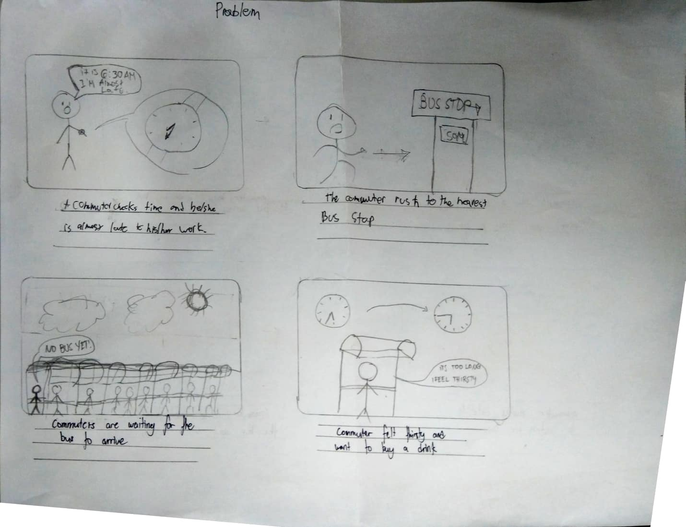
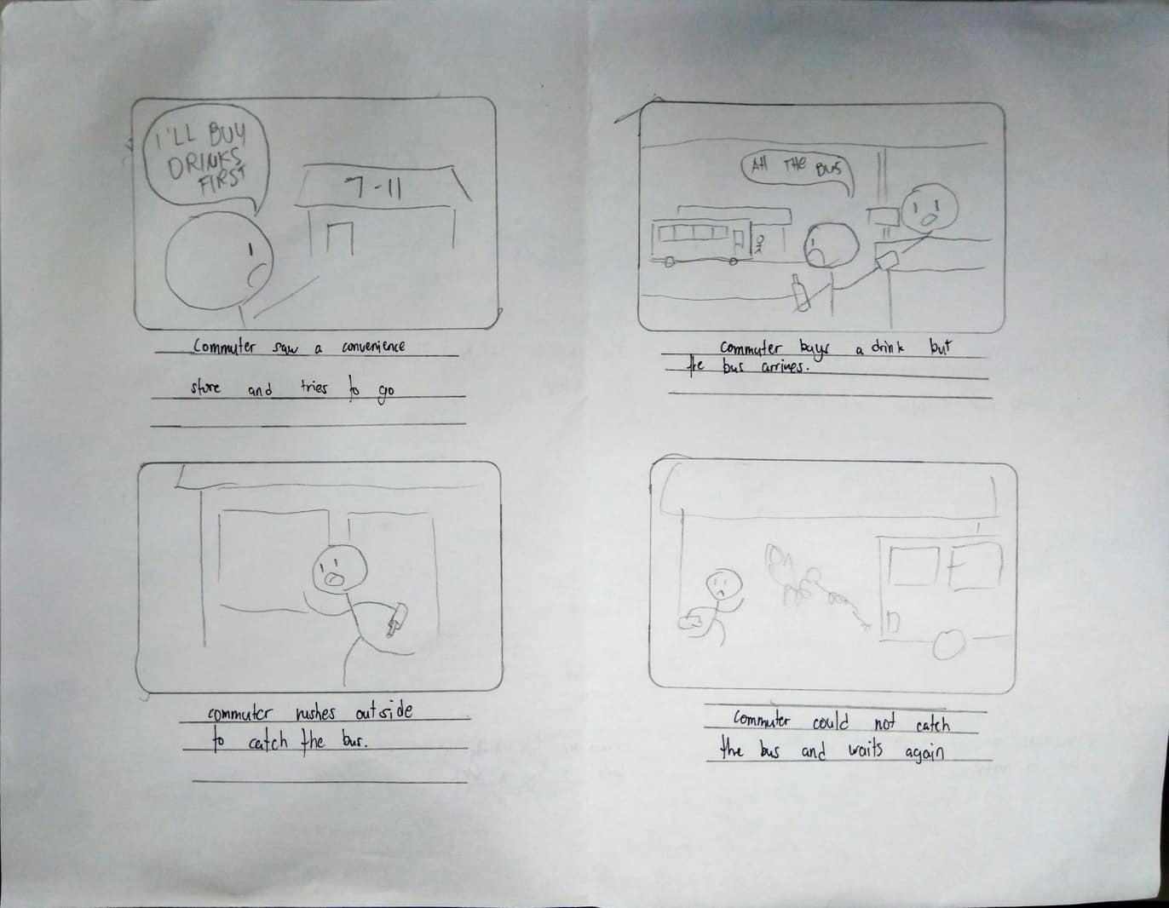
Storyboard

Slide 10
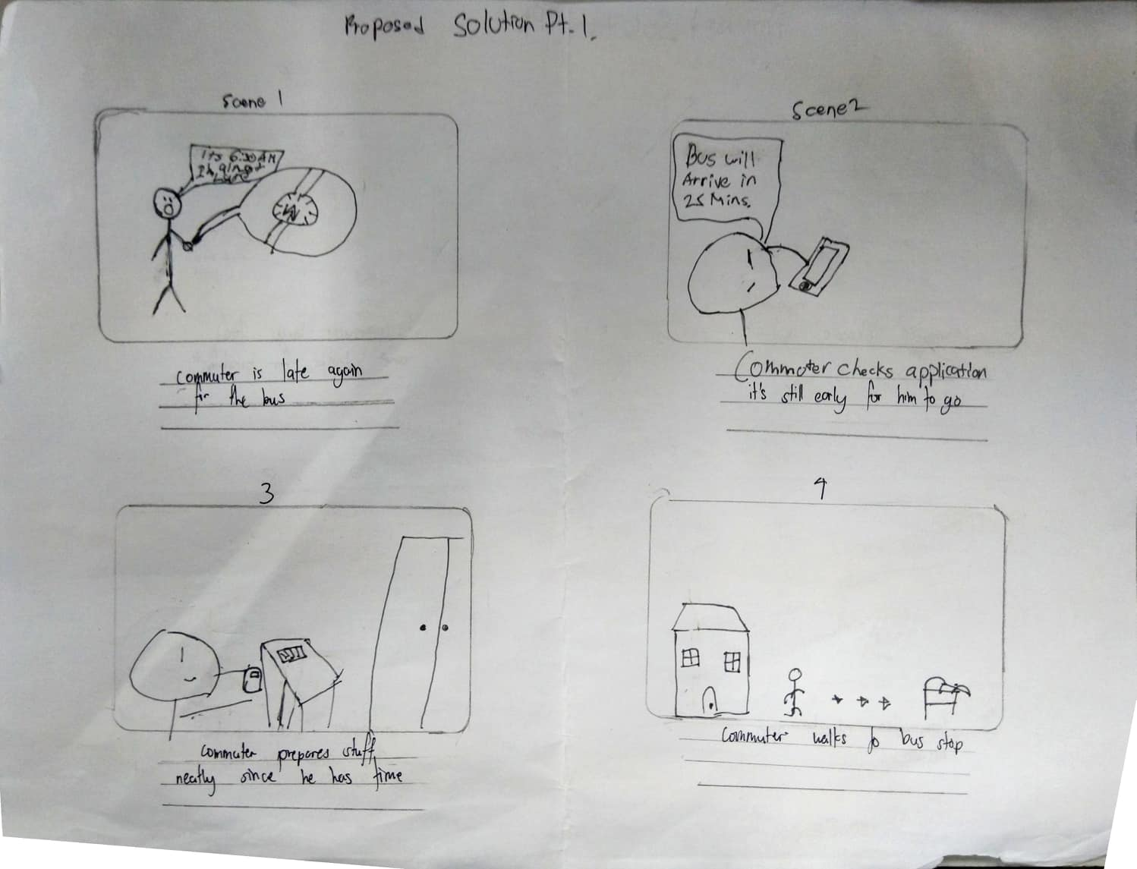
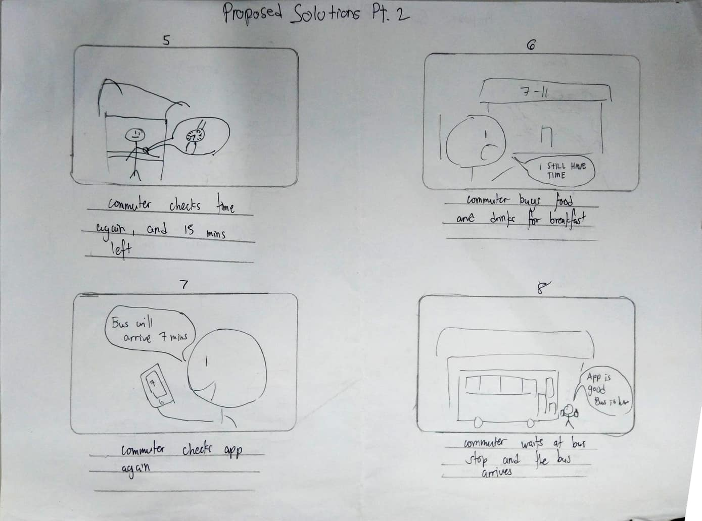
Proposed solution

